Slide 1
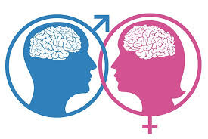
THE MALE AND FEMALE BRAIN

Slide 2
.

Slide 3
.

Slide 4
distinct (adj)
obvious,
noticeable,
separate
She has a distinct English accent.
There's a distinct difference between the two sisters.

Slide 5
biology (n)
anatomy, life science
The study of biology gives insight into the life and the activities of all the living organisms.

Slide 6
verbal (adj)
relating to words
spoken, oral
verbal x non verbal
(not spoken)
Body language is a non verbal communication that consists of face expressions, eye movements and body posture.
verbal ability
verbal communication
verbal intelligence

Slide 7
extensive (adj)
large in extent, comprehensive, thorough
Extensive reading is reading as much as possible, for your own pleasure, at a difficulty level at which you can read smoothly and quickly without looking up words or translating to English as you go.
extensive fields
extensive X intensive
extend (v)
extension (n)

Slide 8
made up of (phr)
to be built from or
consist of stg
Almost 99% of the mass of the human body is made up of six elements: oxygen, carbon, hydrogen, nitrogen, calcium, and phosphorus.

Slide 9
conduct (v)
direct, control, manage, lead, guide
to conduct a research/a test/an experiment/
a tour/business/an orchestra
The scientists conduct experiments to test their hypothesis.
Cem Mansur conducted the Helsinki Philharmonic Orchestra.

Slide 10
recall (v)
remember,
recollect
I can’t recall the last time we met.
Your face is familiar, but I can't recall your name.

Slide 11
three-dimensional (adj)
3D – having height, width and depth
three-dimensional
characters/images/
movies
Three dimensional movies use polarized light, and special glasses, to create two films, one for each eye.

Slide 12
route (n)
path,
direction,
road
The route to success requires hard work.
the most direct route to the town centre

Slide 13
landmark (n)
historical or
notable sight
The Maiden's Tower is one of the landmarks in Istanbul.
Possibly the most famous landmark, the Blue Mosque has stood proud since 1616.

Slide 14
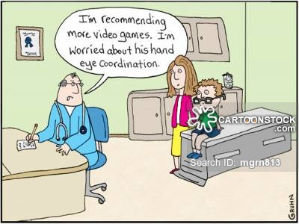
coordination (n)
balanced and effective interaction
of movement or
actions
Playing online games makes it easy for kids to improve their hand-eye coordination.
coordinate (v)
coordinator (n) the person

Slide 15
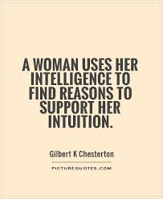
intuition (n)
instinctive knowledge or belief, insight

Slide 16
sense (v/n)
sense (v) become aware of, perceive
sense (n) awareness, perception eg: the sixth sense
make sense (v) be reasonable, understandable
sensible (adj) logical, reasonable
sensitive (adj) responsive to feelings
nonsense (n) absurdity, crazyness
commonsense (n) sound judgment not based on specialized knowledge.
Animals can sense disasters before they even happen.

Slide 17
interpret (v)
explain the meaning of, define, translate
Can you interpret this picture?
interpretation (n)
interpretor (n) translator

Slide 18
hunter (n)
a person who hunts animals for food or in sport
A hunter shoots a bear.
A deer hunter

Slide 19
superior (adj)
better, greater, higher, excellent
superior x inferior
superiority x inferiority
Albert Einstein was of superior intellect.
A 100% cotton garment is superior in quality to a polyester one.

Slide 20
raise (v)
to bring up, grow, breed --- raising children
to increase
Raising children is much harder than it looks, but with patience and hope, children can mature into very emotionally-secure adults.

Slide 21
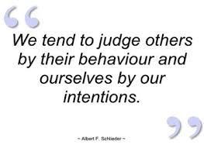
tend (v)
to be likely to do stg
She tends to be nervous before her lectures.
Children tend to prefer sweets to vegetables.
tendency (n)

Slide 22
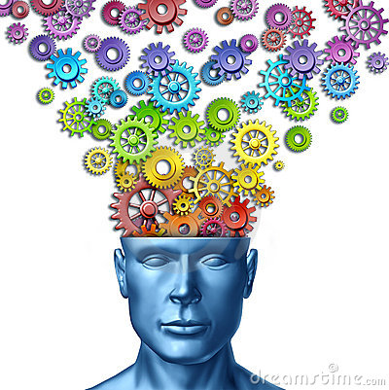
imagine (v)
to form a mental image of
to think, believe, guess
He imagines a better life abroad.
Try to imagine you are on a beautiful beach.
İmagination (n)
imaginative (adj)

Slide 23
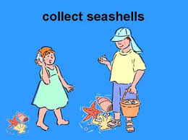
collect (v)
to bring together,
gather
The teacher collected the exam papers.
collection (n)
collective (adj)

Slide 24
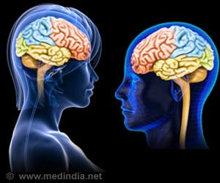
Paragraph 1
Are there any differences between male and female brains?
What factors have an influence on the way male and female brains work?

Slide 25
Research reveals…
major distinguishers between male and female brains.
Scientists generally study four primary areas of difference in male and female brains: processing, chemistry, structure, and activity.

Slide 26
Gray matter/White matter
Male brains utilize nearly seven times more gray matter for activity while female brains utilize nearly ten times more white matter.
What does this mean?

Slide 27
Gray matter
Gray matter areas of the brain are localized.
They are information- and action-processing centers in in a specific area of the brain.
Once they are deeply engaged in a task or game, they may not demonstrate much sensitivity to other people or their surroundings.

Slide 28
White matter
White matter is the networking grid that connects the brain’s gray matter and other processing centers with one another.
That may be the reason why girls tend to more quickly transition between tasks than boys do.

Slide 29
.

Slide 30
Structural differences
Females often have a larger hippocampus, our human memory center.
Females also often have a higher density of neural connections into the hippocampus.
As a result, women tend to input or absorb more sensorial (information to and from all five senses) and emotive information than males do.

Slide 31
Paragraph 2
What kind of abilities do girls and boys develop?
What is the function of the ‘corpus callosum’?
How does it differ in male and female brains?

Slide 32
The left & right hemispheres

Slide 33
Functions of the two sides

Slide 34
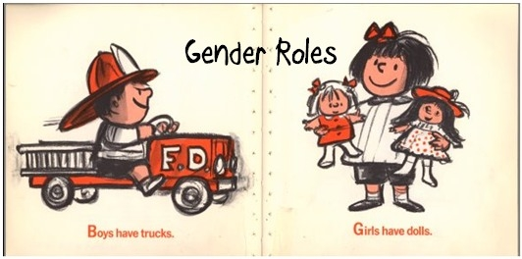
Paragraph 3
Why do girls and boys play with different toys?

Slide 35
What if…?

Slide 36
Paragraph 4
Who is generally better at tasks that require spatial ability?

Slide 37
Visual memory
Who remembers the route better?

Slide 38
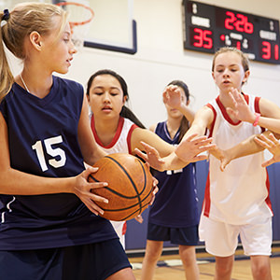
Physical coordination

Slide 39
Paragraph 5
Why are women better at processing information?

Slide 40
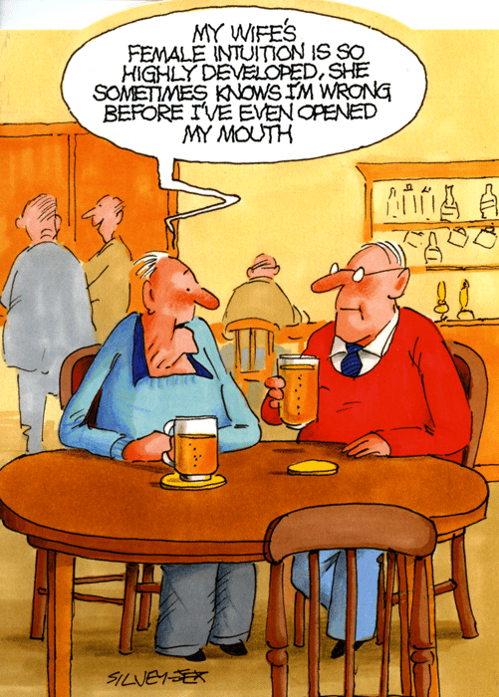
Paragraph 6
How does science explain female intuition?

Slide 41
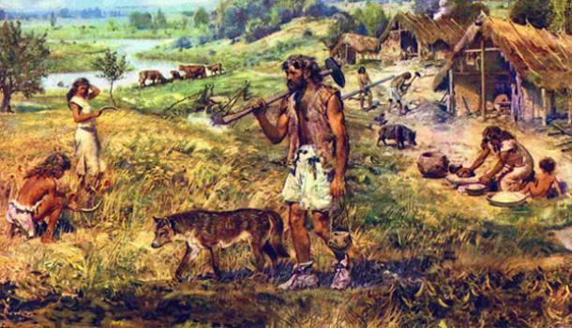
Paragraph 7
How did differences in male and female brains develop?

Slide 42
Paragraph 8
What is the main idea of this paragraph?

