Slide 1
ORAL PRESENTATIONS

Slide 2
?

Slide 3
First Impression

Slide 4
Using Visuals

Slide 5
.

Slide 6
KISS Principle

Slide 7
Steps to follow:

Slide 8
BEFORE THE PRESENTATION
Planning:
Think about 3 wh- questions:
WHY?--- Objectives (What is your aim? to inform, to persuade or to entertain?)
WHO? --- Audience (Who is going to listen to you? Your friends, your boss, your customers?)
WHAT? ---Content (What are you going to talk about?)

Slide 9
Rehearsing
Talk in front of a friend/family member
Become more familiar with what you want to say
Do not use words you do not understand!
Identify your weaknesses
Check your timing

Slide 10
Planning

Slide 11
Outlining
I. Making an Oral Presentation
A. Before the Presentation
1. Planning
2. Outlining
3. Using Visual Aids
4. Rehearsing
B. During the Presentation
1. Delivery
a. Introduction
b. Main Body
c. Conclusion
2. Language
3. Holding attention
C. After the Presentation
1. Questions and Answers
2. Thanking

Slide 12
Planning
The basic structure of a talk:
Introduction
Body
Conclusion
Question & Answer session

Slide 13
INTRODUCTION

Slide 14
Arousing Interest

Slide 15
Possible Introduction Scheme:
Welcome your audience and introduce yourself
2. State the purpose of your talk
3. Give a route map
(tell them how long your talk will take)
4. Give the rules
(do you allow to be interrupted or
should your audience keep questions until the end?)

Slide 16
Useful Language for the Introduction
Good morning, ladies and gentlemen.
Welcome to my presentation.
It’s very nice to see you all here today.
Can we get started?
Let me say just a few words about my background...

Slide 17
.
What I want to do this morning is to …..
My talk will take about 15 minutes.
During my presentation, I’m going to be focusing on four main areas.
If you have any questions, or comments you’d like to make, please do not hesitate to stop me.

Slide 18
Signposting/Signalling
Giving signals to your audience
to know where they are and
what is coming next.

Slide 19
Signposting Language for the Introduction
Good morning, my name is ...
I am going to talk about ...
My presentation is divided into three parts... First, we will look at .... Second,...
The presentation will last for 15 minutes.
After the presentation, we will have 10 minutes for Q&A.

Slide 20
Signposting for the Main Body
First,... Second,... Third...
Moving to the second point...
An example of this is...
Now let's look at...
When we look at the graph on the slide, we can see that...

Slide 21
While Delivering the Presentation:
Take the follwing into consideration:
audience rapport: agreement, understanding between people
eye contact
a comfortable, upright posture
body language, gestures and facial expressions
audible voice

Slide 22
Conclusion
When you come to the end of your presentation you need to indicate this to the people.
Don’t just end up abruptly without giving a conclusion.

Slide 23
Signposting for the Closure
This brings me to the end of my presentation.
Let me just run over the key points again…
To sum up briefly…
To conclude …
As we’ve seen…
So, my recommendation is ….
I would welcome any suggestions.

Slide 24
Thanking the audience & Inviting questions
Thank you for your attention and if you have any questions I’ll be pleased
to answer them.
I’ll be happy to answer any questions.
Are there any questions you’d like to ask?

Slide 25
Practice
PRACTICE MAKES PERFECT!
Prepare everything: words, visual aids, timing, equipment.
Rehearse your presentation several times and time it.
Is it the right length?
Are you completely familiar with all your illustrations? Are they in the right order?
Can you give good comments to your visuals?
How will you answer difficult questions?
Do you know the room? Are you confident about the equipment?
When you have answered all these questions, you will become more confident.

Slide 26
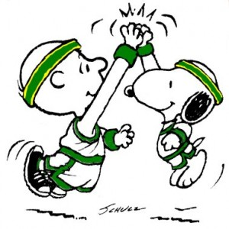
Target Vocabulary accomplishment (n)
stg successfully done, completed
Her family is proud of her academic accomplishments.
an impressive
accomplishment
accomplish (v)

Slide 27
on behalf of (adv)
As a representative of someone,
on the side of, in support of
The teacher accepted the award on behalf of the whole class.

Slide 28
overview (n)
(n) a general survey,
summary
I was asked to give an overview of the company's sales figures.
In business, you take an overview of a problem and then think of the best solutions.

Slide 29
hesitate (v)
be uncertain,
doubt, wait,
pause
Don’t hesitate to contact me if you need any more information.

Slide 30
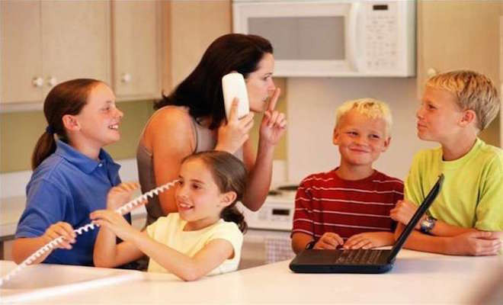
interrupt (v)
cut,
break,
disturb,
interfere
Sorry to interrupt, but I need to ask you to come downstairs.
My studies were interrupted by the war.

Slide 31
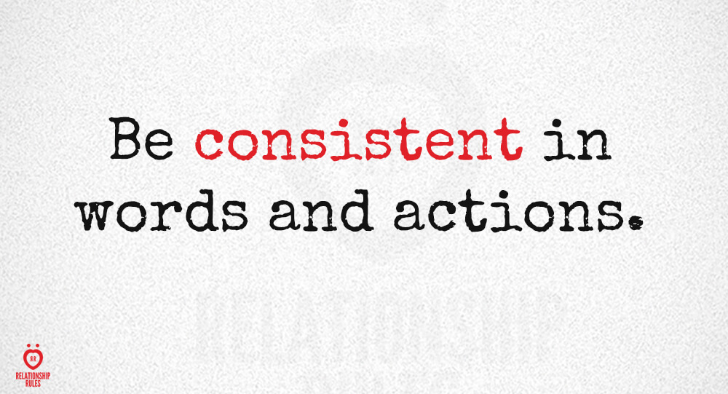
consistent (adj)
compatible,
logical,
agreeing
The results are consistent with earlier research.
The Company's accounting policies are consistent with previous years.
consistently (adv)

Slide 32
elaborate (v)
make stg more detailed, explain, clarify
This argument will be elaborated more fully in the next chapter.
What exactly do you mean by «traditional education"? Would you care to elaborate?

Slide 33
audible (adj)
loud,
distinct,
easily heard
His voice was barely audible above the noise of the generator.

Slide 34
clarify (v)
make stg clearer and
easier to understand
Could you clarify one or two points for me?
The report aims to clarify how these conclusions were reached.

Slide 35
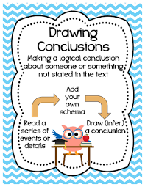
draw a conclusion (v)
conclude
decide,
settle an issue
It would be unwise to draw firm conclusions from the results of a single survey.
reach a conclusion
come to a conclusion

Slide 36
.
THANK YOU
FOR LISTENING :--)

