Slide 1
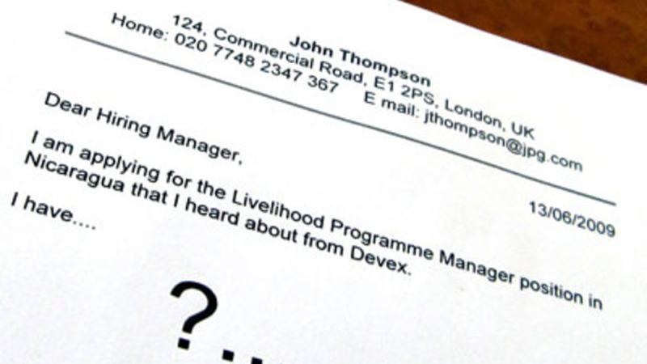
WRITING A COVER LETTER

Slide 2
Before writing
gather information about yourself,
the company,
and the job.

Slide 3
?
Read the job advertisement carefully
Research the corporate website, read and try to understand their mission statement
Call "insiders" (people that work with the company)

Slide 4
Cover Letter/ Covering Letter
In 3-4 paragraphs say…
1) that you would like to apply and
where you found out about the job
2) why you would like the job and
why you are qualified to do the job
3) you can provide more information if necessary
4) when you would be available for interview

Slide 5
Parts of a Cover Letter
A cover letter is comprised of several parts:
your contact information
salutation
introduction
body
closing
signature

Slide 6
Contact Information
Your name,
address,
phone or cell phone number,
your email address (Never use a “cutesy” email address that refers to your hobbies or political opinions – your email address needs to reflect your professional identity, not your sense of humor.)
your LinkedIn address (if you have one).
Employer’s contact information

Slide 7
Salutation
Review the company’s website and
try to find a contact person’s name.
Dear Hiring Professionals: Dear Selection Committee:
Dear Ms. Kincaid: (For Amy Kincaid) Dear Pat Thompson: (For Pat Thompson)
Dear Mr., Mrs., Ms., Miss, Chan

Slide 8
Introduction
Be as specific as possible in this section.
Mention where you heard about the job.

Slide 9
Introduction
I am writing to apply for the post/position of … advertised in yesterday’s …
I am writing with regard to the vacancy in your Sales Department, as advertised in Milliyet on 14th May.
I wish to apply for the post of … which was advertised in today’s ‘Daily Telegraph’.

Slide 10
Introduction
My name is … and I am interested in your current vacancy for a Microbiologist which I saw advertised today on the Dayjob.com website.
I am an intellectually curious and passionate individual who sets myself high standards and who has a proven track in research project management to agreed deadlines, budgets and quality standards.

Slide 11
Introduction
Dear Ms Williams,
I was very excited to see your vacancy for a ..............,. which was advertised yesterday on the www.dayjob.com website. I am a well qualified ............... who would be an excellent choice for this position.

Slide 12
Introduction
As a Purdue University junior in Electrical Engineering, I would like to fill the position of Engineering Internship advertised on General Electric's website.
I believe that my production experience, design skills, and enthusiasm for writing make me a strong candidate for the Production/Design Internship.

Slide 13
Introduction
I agree that a team spirit and strong work ethic are vital for success, and I believe I can bring these qualities to your company.

Slide 14
Body
Focus on your most relevant skills and strengths when writing resumes and cover letters.
show why you are a good match for the job and the company.

Slide 15
Body
I am currently …
At present I am employed as …
I was employed as a (position) by (company) from (date) to (date).
During this time, I held the position of …
I have received training in …
I hold a degree in …
The reason for my seeking a new position is that I wish to pursue a career in …

Slide 16
Body
My communication skills in the workplace have grown because of my internships. When I was an intern at Newberry & Jones, I wrote memos and letters to customers and colleagues on a daily basis. This experience taught me to write professionally and to-the-point.

Slide 17
Body
While at Purdue University, I participated in a collaborative web-consulting project for a Technical Writing class.
With two peers, I served as a web consultant for a local business, Patters' Painters.
We conducted interviews, observed the workplace, and completed multiple web analyses.
I believe these experiences match the requirements you outline in the job description.

Slide 18
Closing
Close with a strong reminder of why you are a good match for the job position and the organization.
Request an interview in some way.
Provide contact information.
Thank them.
Sign your name.

Slide 19
Closing
I would be happy to discuss my suitability for this position further.
I look forward to meeting you in person to discuss what I can offer your company.
Please find my enclosed CV.

Slide 20
Closing
I would appreciate a reply at your earliest convenience.
I would be pleased to supply you with any further information.

Slide 21
Closing
I am eager to speak with you and discuss my possible contribution to Country Press, as I feel my experiences in communication and customer service will be an asset to the company.
Please contact me at 423-512-1143, or email me at anyone@anywhere.com.
Thank you for your time and consideration.

Slide 22
Before your signature
Yours sincerely,
Yours faithfully,
Yours truely,
Best regards,
Kind regards,

Slide 23
Target Vocabulary consideration (n)
Thank you for your time and consideration.
If you are requesting a benefit or an opportunity, such as when you apply for a new job, end your email with this sentence.

Slide 24
fine-tune (v)
to make very small adjustments to stg in order to improve the way it works
There, I fine tuned my communication skills and improved on my ability to provide excellent costumer service.
fine-tune the temperature of the room

Slide 25
pursue (v)
go after, follow,
have as one’s goal
He chose to pursue a college degree.
Students should pursue their own interests, as well as do their school work.

Slide 26
requirement (n)
sth that is needed,
necessity,
demand
She has fulfilled the general requirements of the course.
He has met the basic requirements for graduation.

Slide 27
to be intrigued with/by
To be very interested in stg,
He was intrigued by her reaction.
intrigued to know/learn etc
She was intrigued to know what he planned to do next.

Slide 28
enhance (v)
improve, strengthen
The company is looking to enhance its earnings potential.

Slide 29
maximize (v)
blow up, increase
This program will teach you how to maximize your strengths while minimizing your weaknesses.
maximize X minimize

Slide 30
attend (v)
to be present at,
to go to
More than 1000 people attended the conference.
Karl attended college after military service.

Slide 31
asset (n)
sth or s/o that is useful because they help you succeed or deal with problems
I believe I could be a valuable asset to your organization.
A sense of humor is a great asset in this business.

Slide 32
execute (v)
to carry out a task, implement
They carefully executed the plan.
to kill s/o as a legal punishment
He was executed for murder.
execution (n)
executive (adj)

Slide 33
launch (v/n)
(v) send off, begin, initiate
(n)an event to celebrate or introduce stg new
launch a rocket
launch a satellite
launch a business
She's trying to launch a new career as a singer.

Slide 34
in person
- while s/o is actually present at a place,
- personally, directly
The president appeared in person at the ceremony.
They met in person after speaking on the phone.

Slide 35
appreciate (v)
To be grateful, thankful
I would appreciate if you could reply as soon as possible.
I would appreciate it if you would kindly let me know if there will be a second interview.

