Slide 1
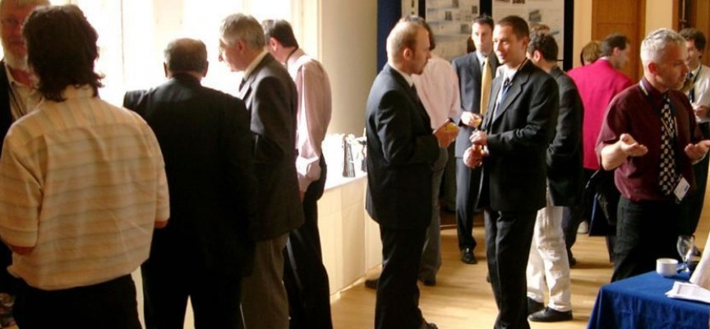
SOCIALIZING IN BUSINESS WORLD

Slide 2
Small Talk
Polite conversation about unimportant things that people make at social occasions
light conversation about common, everyday things; chitchat
We exchanged greetings and small talk about the weather.

Slide 3
Topics for Small Talk

Slide 4
breaking the ice
to relieve shyness or reserve, esp between strangers
to make a start toward getting better acquainted

Slide 5
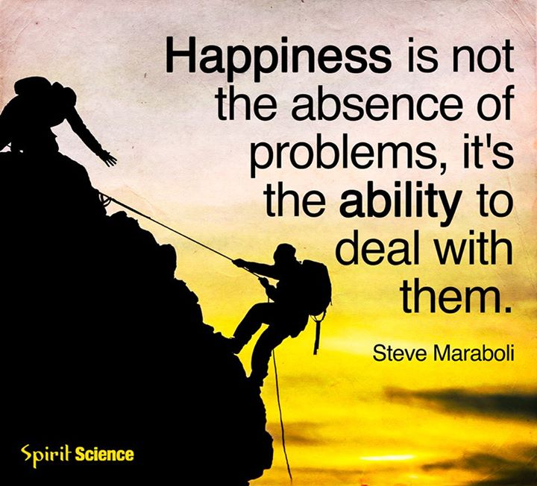
deal (v)
to take the necessary action, especially in order to solve a problem,
handle
I spend most of my working day dealing with customer inquiries.

Slide 6
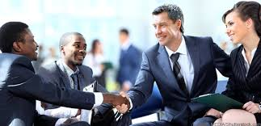
deal (n)
an agreement between two or more people or groups that helps each in some way
business deals
I'll make you a deal. If you help me fix my flat tire, I'll buy you dinner.

Slide 7
extensive (adj)
broad, large,
comprehensive
an extensive reading list
He's had extensive [=considerable] training in this area.
The storm caused extensive damage.
extensive X intensive

Slide 8
keep up to date with (phr)
to be informed about the most current and
accurate information about something
I try to make a point of keeping up to date with news from around the world.

Slide 9
persuade (v)
to convince someone to do stg
Advertisers play on emotions and try to persuade us to buy things.

Slide 10
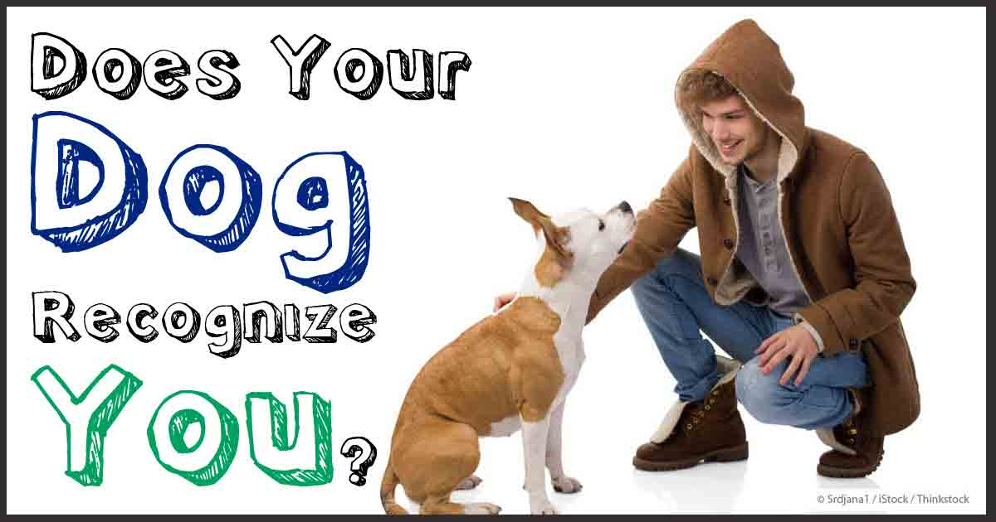
recognize (v)
know,
identify
I didn’t recognize you in your uniform.

Slide 11
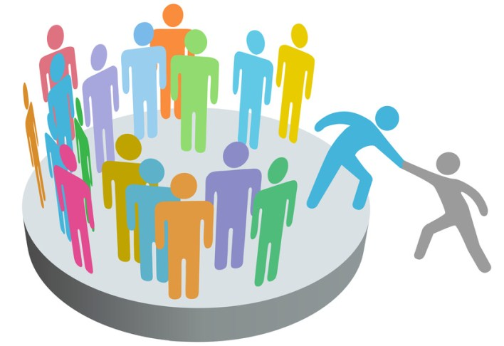
join in (v)
to take part in stg with another group, company, or organization
We would be eager to join in projects of that sort.

Slide 12
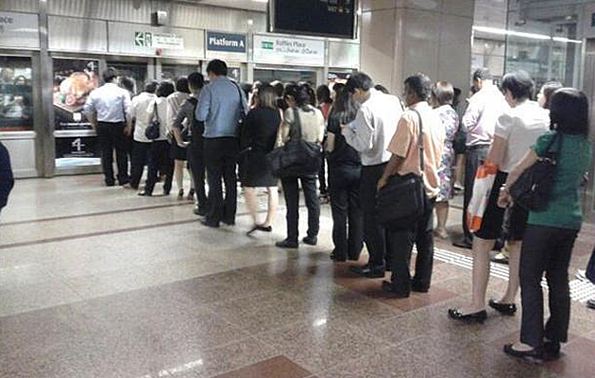
queue (n)
A line of people waiting to enter a building,
buy stg etc.
There was a long queue to get into the cinema.

Slide 13
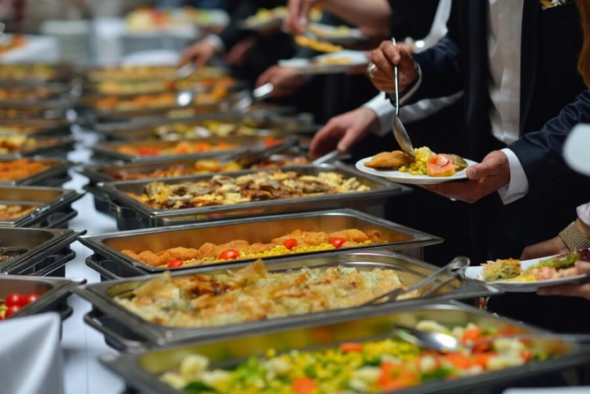
buffet (n)
a place in a railway station, bus station etc where you can buy and eat food or drink
A cold buffet
The price includes morning coffee, buffet lunch, and afternoon tea.

Slide 14
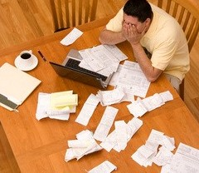
daunting (adj)
alarming,
frightening,
difficult
Few things are more daunting than having to speak in front of a large crowd.
The interview process can be daunting.

Slide 15
engage in a conversation
communicate,
discuss,
speak
You can engage in a conversation by asking open questions such as: – what brings you here today? – have you come from far to be here today?

Slide 16
strike up a conversation
to start a conversation with someone
I struck up an interesting conversation with
someone on the bus yesterday.
Some people can easily strike up a conversation with each other when they are travelling.

Slide 17
convenient (adj)
appropriate,
useful,
Favorable
When is a convenient time for you to meet?
a convenient method/way/means of cleaning windows

Slide 18
urgently (adv)
very important and needing to be dealt with immediately
Volunteers are urgently needed to help with the crisis.
speaking/calling urgently

Slide 19
prospective (adj)
potential,
anticipated
a seminar for prospective home buyers [people who are likely to buy a home fairly soon]
prospective parents/students/employers

Slide 20
commitment (n)
assurance,
obligation,
responsibility,
promise to do stg
The boss noticed her strong commitment to her work.
She rejected the invitation by saying "I am very sorry, I already have a commitment for that time."

